Slide 1
Conducting Ethical Research with the
Richmond University Ethics Committee
GEP3105: Tools for Change
Richmond Ethics Committee and The Department of Psychology
Slides by Tavis Ryan King & Noga Glucksam

Slide 2
Learning Goals
1.
2.
3.
4.
5.
6.
7.
Define ethics, and explain why they matter for academic research.
Explain the role of professional ethical guidelines.
List what CCCDDWP (Triple C-Double D-W-P) mean for preparing an ethical research project.
Identify what the Data Protection Act 2018 and the General Data Protection Regulation framework are, and their relevance for academic research.
List seven things Richmond students can do to protect participants’ data in academic research.
Outline Richmond American University London’s Ethical Research policy and process.
Study the student ethics form for submission to the Research Ethics Committee.

Slide 3
Ethical Issues
What are ethics, generally speaking?

Slide 4
Ethics in Research
It is not enough to simply select participants for a study wherever you can find them.
Research can directly or indirectly cause psychological, cultural or physical harm to a person, community or culture if it disregards the rights or interests of its participants.
Researchers who work with human participants must consider the psychological well-being, health, values and dignity of their participants.
Even if there are no participants involved, many topics may affect other people, requiring the researcher to take a moment and consider this impact.
Remember, the overall aim of research is to improve the lives of people. If we aren’t concerned for human welfare from the start, we are not achieving this goal.

Slide 5
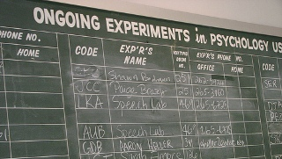
Ethical Guidelines
If you were to recommend to a friend any tips on how to conduct ethical research, what would you suggest?

Slide 6
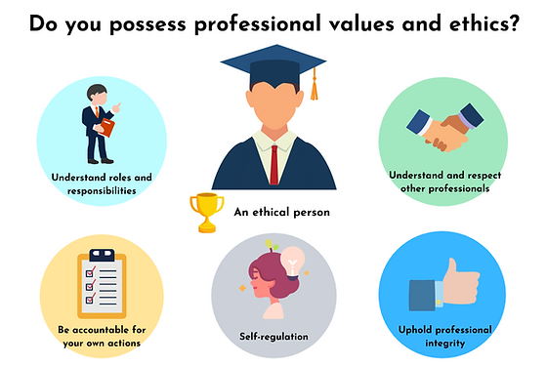
Ethical Guidelines
Different disciplines of study may set different ethical guidelines for how to work with the public in a safe and ethical way.

Slide 7
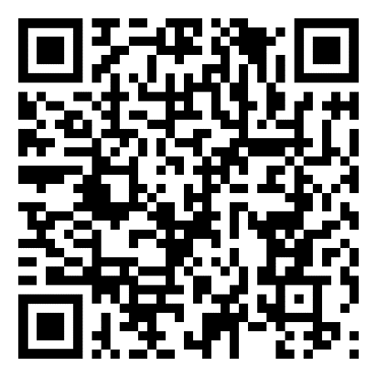
British Psychological Society
In the United Kingdom, psychologists are self-regulated. This means there are no ethical laws apart from the laws of harm that already exist on the books.
For this reason, the British Psychological Society has a code of ethics called, Ethical Principles for Conducting Research with Human Participants which covers nine ethical areas.

Slide 8
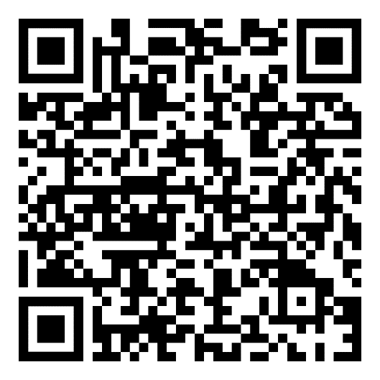
Social Research Association
It’s OK if you’re not a psychologist (you still could be!), because if you are another type of social scientist like a sociologist, a geographer, an economist, or a political scientist, there is a professional set of guidelines for all disciplines.
For example, the Social Research Association broadly covers anyone who does social research with human participants.

Slide 9
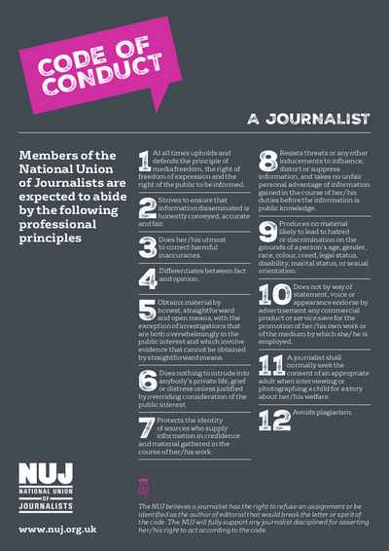
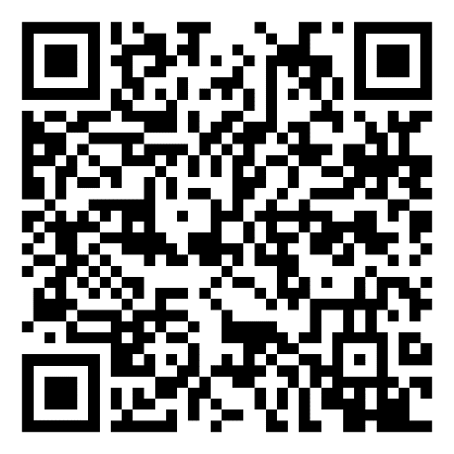
National Union of Journalists
If you study journalism in the UK, the National Union of Journalists also offer a code of conduct.

Slide 10
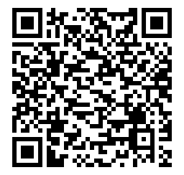
British Educational Research Association
While none of us are studying to become teachers or study education as such, The BERA ethical guidelines are very good ethical guidelines as they are designed for people who work in educational settings, and therefore BERA guideline technically apply to all disciplines!

Slide 11
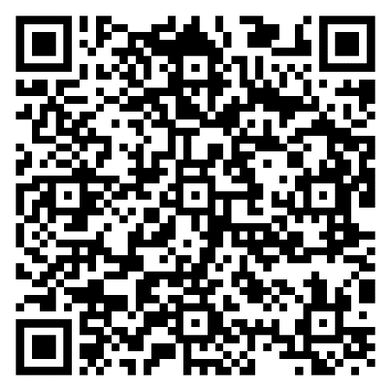
Business Research Ethics
Even business researchers can subscribe to ethical guidelines set by sector leaders to balance the need of protecting participants from harm against gaining new knowledge about sales and organisational behaviours.

Slide 12
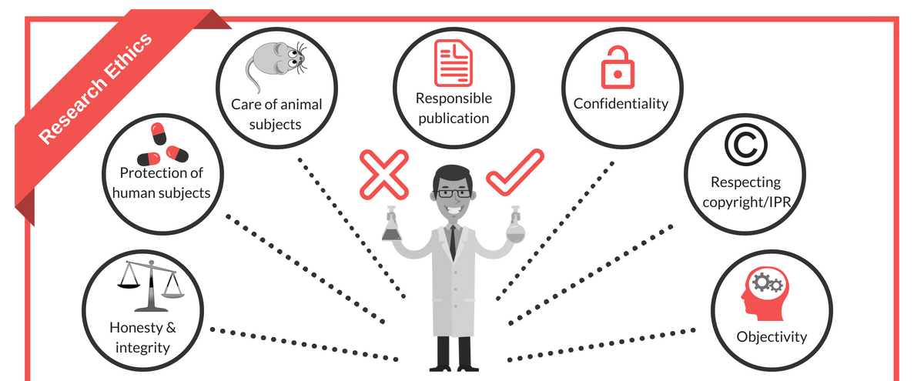
Ethical Principles
As I am a psychologist, I can share what my ethical guidelines are as a default when designing research projects.
I use the expression, “CCCDDWP” to help me.

Slide 13
Consent
When someone consents to participate in research, their consent must be informed, i.e., the aims of the research should be made clear.
In addition, anything that may influence their willingness to participate must be disclosed. Where research involves children less than the age of 16-years-old, then consent must be obtained from parents or guardians of the child.
There are other ways to get consent besides informed consent:
Presumptive Consent – When a researcher gets consent from a similar group of people, or a panel of experts, if the study is safe.
Prior General Consent – Participants give permission to take part in several studies, including one that may involve deception. In this case, they are agreeing to be deceived.
Retrospective Consent – Participants are asked for their consent in the debrief after the study is over.

Slide 14
Confidentiality
Definition
Participation in psychological research should be confidential, meaning that it is anonymous and private for the participant.
When you have finished collecting data, you must: (1) Strip the dataset of identifying information like names and IP addresses, and (2) use an anonymised Participant Number or ID in its place. The participant has the ID if they need to contact you later about their data..
If confidentiality cannot be assured, then this must be disclosed to participants before they consent to participate in the research.
However, if a participant discloses something illegal, like terrorist acts, this is legally allowed to be disclosed to authorities.

Slide 15
Colleagues
Importantly, social scientists and researchers should never work alone. When we create ideas for new studies, we often are so excited by the new idea, we tend to have blind spots as to the ethical risks the new study poses. Our eagerness may lead us to rush into research before fully considering the harm. Furthermore, even after the study starts, we may not be seeing the harm as we are so enamoured by the potential results.
This is why it is important to discuss work with colleagues.
The Research Ethics Committee – All universities with social research have some type of ethics committee that reviews research before it starts to assess the potential for harm.
The Academic Supervisor – All research projects have a supervisor, a person with more research experience to support new students in undertaking human research.
Colleagues and Peers – The fellow students you work with can also give you feedback about their concerns and you should listen respectfully and consider their point before being defensive.

Slide 16
Colleagues
A good example of ‘colleagues’ protecting psychology and participants is the story of Christina Maslach and Philip Zimbardo.
Maslach and Zimbardo were dating when the Stanford Prison Experiment was occurring, and she challenged Zimbardo on his ethical treatment of the student ‘prisoners’. This made Zimbardo reconsider what he was doing and he ended the study.

Slide 17
Deception
Definition
Deception is the act of misleading participants through lies or misleading information, if those participants are likely to object when debriefed at the end of a procedures.
Alternatives to deception should always be considered.
Moreover, deception prevents the participant from giving informed consent. They may find themselves in research that is against their wishes.
Additionally, deceptions earns social scientists a reputation of distrust for the future, and reduces our professional credibility and public relationships

Slide 18
Debriefing
Definition
Debriefing is the
process of
informing
participants of
the aim of
research after
the event.
Following an investigation, participants should be fully informed about the nature of the research.
The participants’ experiences of the research should also be discussed.
However note, debriefing following an investigation does not justify the use of an unethical procedure.

Slide 19
Right to Withdrawal
Definition
Participants have the right to withdrawal which is the ability to choose whether or not to continue participating in an investigation.
Participants also have the right to withdraw at any time (beginning, middle, end, or after), regardless of whether or not they were paid for participation.
They also need to be informed of their right to withdrawal during the consent stage and after the study is completed.
If a participate does ask to be withdrawn, researchers must destroy any data or information that was collected (so participant numbers are a must!).

Slide 20
Protection of Participants
Social researchers have a
responsibility for protecting
their participants from
physical or mental harm.
This includes undue stress.
The risk of harm to a
participant must not be
greater than that to which
they are exposed to in
everyday life.
This is relative. That is to say, asking just anyone to skydive for an experiment is not what they are exposed to every day, however, asking an experienced skydiver to jump would be OK because this is what they frequently do.

Slide 21
Triple C-Double D-W-P
C
Confidentiality
C
Consent
C
Colleagues
D
Deception
D
Debriefing
W
Withdrawal (Right to)
P
Protection from Harm

Slide 22
Social Science Research and Secondary Data
However, not all social scientists are psychologists and not all social scientists work with primary data taken from human participants (Flanagan et al., 2015, p. 190).
Many social scientists work with secondary data. Secondary data is data collected and distributed by another source (for example, census data; Flanagan et al., 2015, p. 190).
Moreover, secondary data could also be analysing things like historical documents, discourse, or interview texts and videos conducted by other journalists. In these situations, you do not need ethical permission from the Richmond Ethics Committee…
…but you still should reflexively consider the ethical impact of your use and analysis of this data and potential conclusions could be in regards to the social sensitivity of the public.

Slide 23
Data Protection
What does the term ‘data protection’ suggest to you?

Slide 24
Data Protection Laws
Key Term
Law
Law
In most ethical principles, academics are self-regulating, meaning they police their own behaviour’ there are no special laws around the ethics of research in the UK. However, there are laws around the security of the data we collect.
The Data Protection Act 2018 requires everyone in the UK to keep data secure; Article 5 encompasses the European Union’s General Data Protection Regulation (GDPR) post-Brexit.
The Data Protection Act/GDPR law effectively requires all organisations (academic or otherwise) to adhere to seven principles of data collection, storage, use, and destruction.

Slide 25
Lawfulness, Fairness and Transparency
Purpose Limitation
Data Minimisation
Accuracy
Data collection must be collected for a lawful reason (Article 6), fairly analyse data, and be transparent to participants about its use.
Researchers must tell the participants the reason the data was collected (either in the informed consent or debrief).
Only collect the data you intend to use. Don’t capture loads of data about the participants you have no intention to report or analyse.
Data collected should be kept up-to-date (not super relevant to research, but perhaps for marketing and business data).

Slide 26
Storage Limitation
Integrity and Confidentiality
Accountability
Researchers may not hold personal data for any longer than is necessary. I recommend research data intended for publication is held for 10 years in case it is needed for meta-study of for questions of transparency, reliability and/or validity.
You must keep data appropriately secure so it is not lost or stolen.
You must be responsible for the data you keep and its secure storage and compliance with the Data Protection Act 2018/GDPR.
Student project data should be destroyed when your grade has been confirmed by the moderation process, or when you graduate university
We recommend a double-lock mechanism. Keep data in your Richmond Drive (one password) and put it in a password-protected folder (second password).

Slide 27
So what do I do?
So what are the things you think you would have to do to protect your participant’s data?

Slide 28
Student Data Protection Act Steps
1.
2.
3.
4.
Never use Google Forms – Collected data on Google does not comply with GDPR and the Data Protection Act 2018.
Never use your mobile phone – phones are hacked and lost all the time. This is too risky for professional academic research.
Only collect data with Microsoft Forms, which is part of your Micro-soft 365 student package. Your tuition fees paid for it, so use it!
Always keep data behind a double-lock mechanism.
The first lock is easy – it is your Richmond password into Microsoft 365, so no effort on your part.
The second lock you must manually put in place. Password protect the folder you keep the file in or password protect the file itself.

Slide 29
Student Data Protection Act Steps
5.
Separate your informed consent forms from your data.
The informed consent forms have people’s names, emails and often, their Internet Service Provider (ISP) number. This must be stripped and put in a separate document or file.
This also means that you need a separate folder from the folder you contain the data in, and that separate folder also needs a third, different password.
Password 1 Microsoft 365 user password
Split the consent forms from the data into two different files
Password 2 Password Protect the file data is contained within
Password 3 Password Protect the file the consent forms are contained within

Slide 30
Student Data Protection Act Steps
6.
7.
Important, you are not ‘locked into’ computerised data protection, but these principles still apply to traditional measures. If you collect data using cassette tapes, or hand notes for example, just keep these physically locked behind two locks; e.g., your front door lock, and a lock box or fire-proof safe inside your flat.
Anonymise your participants. You can do this by either:
Give each participant a pseudonym (fake name); or
Give each participant a participant number.
Then, only ever refer to the participant by their pseudonym or their number in your report.

Slide 31
Richmond Ethics
The procedure for applying for ethical approval is fairly straightforward!
1.
2.
3.
4.
5.
6.
Plan your study or experiment.
Discuss your research with your supervisor.
Complete the Student Application Form for Research Ethics Approval.
Ask your supervisor to review your Student Application form and sign it.
Submit your form to the ethics committee at ResearchEthics@Richmond.ac.uk as an attachment.
Wait up to 7 working days for your application to be processed.

Slide 32
Research Ethics Application Outcomes
ACCEPTED
Congratulations! You prepared an excellent application that convinced the ethics committee you are safe to proceed.
You may now continue with your research and start collecting data.
REFER AND RESUBMIT
Don’t worry! EVERYONE – even your supervisors, get ethics referred sometimes. Usually it is about something missed in communication, or further clarification is needed. Take it as a learning experience.
The ethics committee will give you feedback on how to improve the application.
DO NOT begin researching. You are violating university policy if you collect data prior approval.
Use the feedback to improve and resubmit again.
If necessary, have another meeting with your supervisor in office hours to discuss how to use the feedback to improve.

Slide 33
The Ethics Form
Let’s take a few minutes to look over the Ethics Application in groups, to discuss and ask questions about it.

Slide 34
Enrichment Multiple Choice Question
1.
A.
B.
C.
D.
What is the ethical practice when a participant’s identity is kept private and anonymous?
Consent
Colleagues
Confidentiality
None of the above

Slide 35
Learning Goals
1.
2.
3.
4.
5.
6.
7.
Define ethics, and explain why they matter for academic research.
Explain the role of professional ethical guidelines.
List what CCCDDWP (Triple C-Double D-W-P) mean for preparing an ethical research project.
Identify what the Data Protection Act 2018 and the General Data Protection Regulation framework are, and their relevance for academic research.
List seven things Richmond students can do to protect participants’ data in academic research.
Outline Richmond American University London’s Ethical Research policy and process.
Study the student ethics form for submission to the Research Ethics Committee.

Slide 36
Referencing this Slideshow
APA 7 Referencing
King, T. R. & Glucksam, N. (2023). Conducting Ethical Research with the Richmond University Ethics Committee [PowerPoint slides]. Richmond American University London Ethics Committee. https://my.richmond.ac.uk/research/SitePages/Research%20Ethics.aspx
Harvard Referencing Style
King, T. R. and Glucksam, N. (2023). ‘Conducting Ethical Research with the Richmond University Ethics Committee’ [PowerPoint presentation]. Richmond American University London Ethics Committee. Available at: https://my.richmond.ac.uk/research/SitePages/Research%20Ethics.aspx (Accessed: INSERT DATE HERE).

